Slide 1


Slide 2
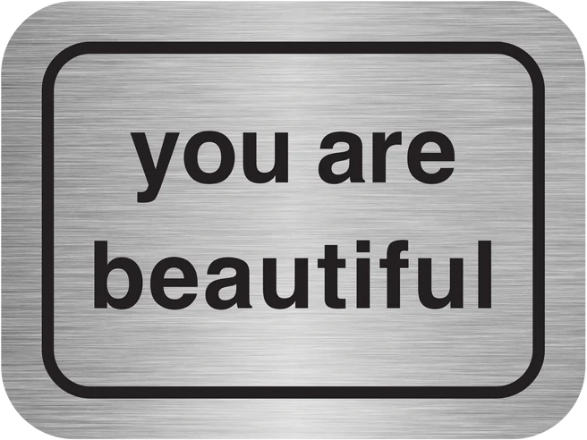
Father when I look in the mirror, I see the me that you made. I realize that every single detail of my appearance is one that you personally chose just for me. I see the me that you meant for me to be.
I am so thankful for the attention and care you gave to forming me.
I love the color and texture of hair that you chose for me, I love the shape of my eyes, which you made. I’m thankful for the set of my mouth and the skin tone you picked out just for me. I’m thankful for the color of my irises and the shape of my face. I’m thankful for the height and build you chose just for me.
Father, when I look in the mirror I see proof that you put aside time to think just of me, that you had an image in your mind and you lovingly crafted me out of your own image to be exactly who I am today.
Father, your hand has made me beautiful because I am created by you, in love, as your child.
Thank you for creating me and thank you for opening my eyes to see your hand and care in all of my features.
~Christy Jordan

Slide 3
Lord, help us to recognize our inner beauty and the beauty that God has created in each of us. We pray to the Lord. Lord hear our prayer
We pray that the girls at AHN will find the beauty within themselves that God has molded and shaped for them. We pray to the Lord. Lord hear our prayer.
We pray for those in our community: Faculty, staff, parents, and alumnae. May they feel the love of God as they look in the mirror and recognize God’s creation. We pray to the Lord. Lord hear our prayer.
We pray for the sick: May the healing hand of the Lord be upon them. We pray to the Lord. Lord hear our prayer.
We pray for those who have passed from this world to the kingdom of heaven. May they be surrounded by the healing presence of God. We pray to the Lord. Lord hear our prayer.

Slide 4
“Fill me with Your beauty, Lord.”
I don’t want to look like a Hollywood star, a perfect model, or Princess Kate on the cover of People. Yes, the world is full of beautiful women. But I don’t just want to look beautiful; I want to pour beauty out into the world.
I really only want to be as beautiful as God chooses to make me. If this face is good enough for Him, then it’s good enough for me, too.
No lotion can renew me. There is not a serum that promises that the best days are still awaiting me just beyond this life. And if there was a potion that could actually turn back the hands of time and make me twenty-five again, I would pour it right down the drain.
Because I want more than eternal youth. I want to be who God has called me to be. For now, that is a thirty-eight year old woman who reads the lines on her face and finds there is a beautiful ballad of God’s faithfulness written there.
His beauty truly outshines us all, and He gives it to all who press themselves close to Him and seek His face. And that’s a miracle worth praying for.

